Slide 1
Vehicle Calculator
Artificial Intelligence design
By Brian Kilburn, Dominic Holt, and Jamie Wiess

Slide 2
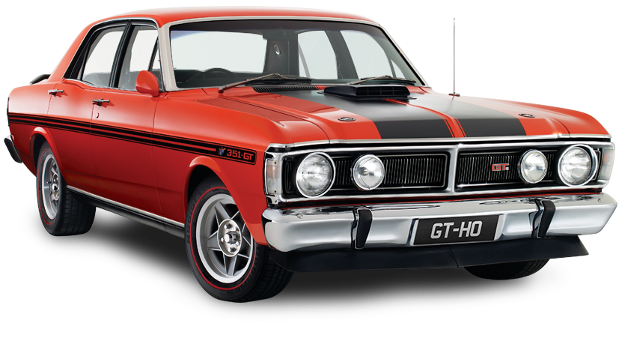
motivation
build an application that had something to do with cars.
Curiosity, vehicle pricing, contributing factors

Slide 3
Related work
https://www.kaggle.com/abineshkumark/carsdata
https://github.com/dkeske/CarPrice
- Linear and ridge regression to predict price of a car based on car adds posted on a website
https://towardsdatascience.com/build-develop-and-deploy-a-machine-learning-model-to-predict-cars-price-using-gradient-boosting-2d4d78fddf09
- 4 regression models based on features. Choosing the model with the best correlation and Root Mean Squared Error

Slide 4
Contribution

Slide 5
Game plan
Utilize Recurrent Neural Network Model to predict calculations
Study RNN, it is that last subject covered in this course
Display results graphically using matplotlib in python
Possible user interaction with GUI implementation

Slide 6
responsibility
RNN Model (tensorflow)
Matplotlib
GUI

Slide 7
Current progress

Slide 8
Vehicle industry
How do they come up with their pricing?

Slide 9
Vehicle industry
How do they come up with their pricing?

Slide 10
Vehicle industry
How do they come up with their pricing?
Origin

Slide 11
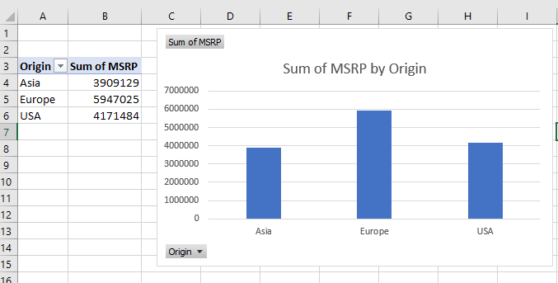
Vehicle industry
How do they come up with their pricing?
Origin:
Europe
Asia
USA

Slide 12
Vehicle industry
How do they come up with their pricing?
Origin
Make

Slide 13
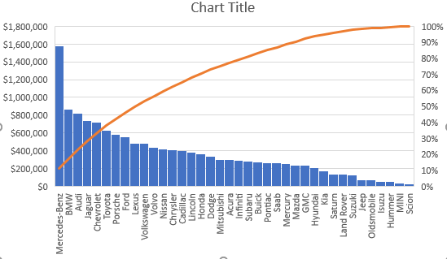
Vehicle industry
How do they come up with their pricing?
Make

Slide 15
Questions?

